Slide 1
Dynamic programming
叶德仕
yedeshi@zju.edu.cn

Slide 2
Dynamic Programming
History
Bellman. Pioneered the systematic study of dynamic programming in the 1950s.
Etymology.
  Dynamic programming = planning over time.
  Secretary of defense was hostile to mathematical research.
  Bellman sought an impressive name to avoid confrontation.
    "it's impossible to use dynamic in a pejorative sense"
    "something not even a Congressman could object to"
Reference: Bellman, R. E. Eye of the Hurricane, An Autobiography.

Slide 3
Algorithmic Paradigms
Greedy. Build up a solution incrementally, myopically optimizing some local criterion.
Divide-and-conquer. Break up a problem into two sub-problems, solve each sub-problem independently, and combine solution to sub-problems to form solution to original problem.
Dynamic programming. Break up a problem into a series of overlapping sub-problems, and build up solutions to larger and larger sub-problems.

Slide 4
Dynamic Programming
Applications
Areas.
  Bioinformatics.
  Control theory.
  Information theory.
  Operations research.
  Computer science: theory, graphics, AI, systems, ...
Some famous dynamic programming algorithms.
  Viterbi for hidden Markov models.
  Unix diff for comparing two files.
  Smith-Waterman for sequence alignment.
  Bellman-Ford for shortest path routing in networks.
  Cocke-Kasami-Younger for parsing context free grammars.

Slide 5

Knapsack problem

Slide 6

0 - 1 Knapsack Problem
Knapsack problem.
Given n objects and a "knapsack."
Item i weighs w_{i} > 0 kilograms and has value v_{i} > 0.
Knapsack has capacity of W kilograms.
Goal: fill knapsack so as to maximize total value.

Slide 7
Example
Items 3 and 4 have
value 40
Greedy: repeatedly add item with maximum ratio v_{i} / w_{i}
{5,2,1} achieves only value = 35, not optimal
Item | Value | Weight
1 | 1 | 1
2 | 6 | 2
3 | 18 | 5
4 | 22 | 6
5 | 28 | 7
W = 11

Slide 8
Dynamic Programming:
False Start
Def. OPT(i) = max profit subset of items 1, …, i.
Case 1: OPT does not select item i.
  OPT selects best of { 1, 2, …, i-1 }
Case 2: OPT selects item i.
  accepting item i does not immediately imply that we will have to reject other items
  without knowing what other items were selected before i, we don't even know if we have enough room for i
Conclusion. Need more sub-problems!

Slide 9
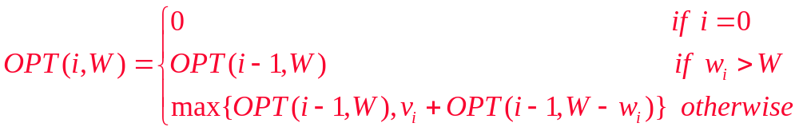
Adding a New Variable
Def. OPT(i, W) = max profit subset of items 1, …, i with weight limit W.
Case 1: OPT does not select item i.
  OPT selects best of { 1, 2, …, i-1 } using weight limit W
Case 2: OPT selects item i.
  new weight limit = W – w_{i}
  OPT selects best of { 1, 2, …, i–1 } using this new weight limit

Slide 10
Knapsack Problem:
Bottom-Up
Knapsack. Fill up an n-by-W array.
Input: n, W, w₁,…,w_{n}, v₁,…,v_{n}
for w = 0 to W
M[0, w] = 0
for i = 1 to n
for w = 1 to W
if (w_{i} > w)
M[i, w] = M[i-1, w]
else
M[i, w] = max {M[i-1, w], v_{i} + M[i-1, w-w_{i} ]}
return M[n, W]

Slide 11
Knapsack Algorithm
W+1
 | 0 | 1 | 2 | 3 | 4 | 5 | 6 | 7 | 8 | 9 | 10 | 11
empty | 0 | 0 | 0 | 0 | 0 | 0 | 0 | 0 | 0 | 0 | 0 | 0
{1} | 0 | 1 | 1 | 1 | 1 | 1 | 1 | 1 | 1 | 1 | 1 | 1
{1,2} | 0 | 1 | 6 | 7 | 7 | 7 | 7 | 7 | 7 | 7 | 7 | 7
{1,2,3} | 0 | 1 | 6 | 7 | 7 | 18 | 19 | 24 | 25 | 25 | 25 | 25
{1,2,3,4} | 0 | 1 | 6 | 7 | 7 | 18 | 22 | 24 | 28 | 29 | 29 | 40
{1,2,3,4,5} | 0 | 1 | 6 | 7 | 7 | 18 | 22 | 24 | 28 | 29 | 34 | 40
n+1
OPT = 40

Slide 12
Knapsack Problem:
Running Time
Running time. O(n W).
  Not polynomial in input size!
  "Pseudo-polynomial."
  Decision version of Knapsack is NP-complete.
Knapsack approximation algorithm.
  There exists a polynomial algorithm that produces a feasible solution that has value within 0.0001% of optimum.

Slide 13
Knapsack problem: another DP
Let V be the maximum value of all items,
  Clearly OPT <= nV
Def. OPT(i, v) = the smallest weight of a subset items 1, …, i such that its value is exactly v, If no such item exists
it is infinity
Case 1: OPT does not select item i.
  OPT selects best of { 1, 2, …, i-1 } with value v
Case 2: OPT selects item i.
  new value = v – v_{i}
  OPT selects best of { 1, 2, …, i–1 } using this new value

Slide 14
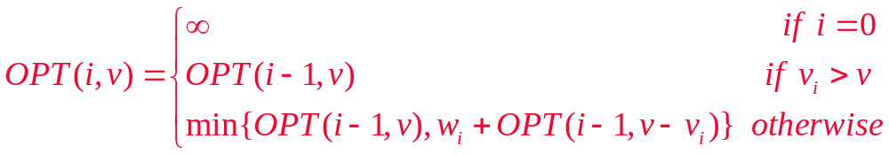
Running time: O(n²V), Since v is in {1,2, ..., nV }
Still not polynomial time, input is: n, logV

Slide 15
Knapsack summary
If all items have the same value, this problem can be solved in polynomial time
If v or w is bounded by polynomial of n, it is also P problem

Slide 16
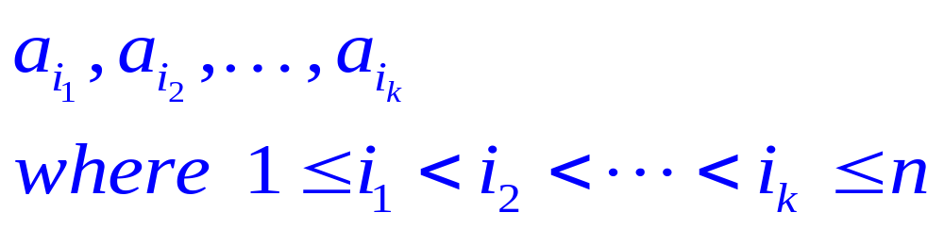
Longest increasing subsequence
Input: a sequence of numbers a[1..n]
A subsequence is any subset of these numbers taken in order, of the form
and an increasing subsequence is one in which the numbers are getting strictly larger.
Output: The increasing subsequence of greatest length.

Slide 17
Example
Input. 5; 2; 8; 6; 3; 6; 9; 7
Output. 2; 3; 6; 9
5 2 8 6 3 6 9 7

Slide 18
directed path
A graph of all permissible transitions: establish a node i for each element a_{i}, and add directed edges (i, j) whenever it is possible for a_{i} and a_{j} to be consecutive elements in an increasing subsequence, that is, whenever i < j and a_{i} < a_{j}
5
2
8
6
3
6
9
7

Slide 19
Longest path
Denote L(i) be the length of the longest path ending at i.
for j = 1, 2, ..., n:
  L(j) = 1 + max {L(i) : (i, j) is an edge}
return max_{j} L(j)
O(n²)

Slide 20
How to solve it?
Recursive? No thanks!
Notice that the same subproblems get
solved over and over again!
L(5)
L(1)
L(2)
L(3)
L(4)
L(1)
L(2)
L(3)

Slide 21
Sequence Alignment
How similar are two strings?
  ocurrance
  occurrence
o
c
u
r
r
a
n
c
e
-
6 mismatches,1gap
o
c
c
u
r
r
e
n
c
e
o
c
-
u
r
r
a
n
c
e
1 mismatch,1gap
o
c
c
u
r
r
e
n
c
e
o
c
-
u
r
r
-
a
n
c
e
0 mismatch, 3gaps
o
c
c
u
r
r
e
-
n
c
e

Slide 22
Edit Distance
Applications.
  Basis for Unix diff.
  Speech recognition.
  Computational biology.
Edit distance. [Levenshtein 1966, Needleman-Wunsch 1970]
  Gap penalty δ, mismatch penalty a_{pq}
  Cost = sum of gap and mismatch penalties.

Slide 23
Sequence Alignment
Goal: Given two strings X = x₁ x₂ . . . x_{m} and Y = y₁ y₂ . . . y_{n} find alignment of minimum cost.
Def. An alignment M is a set of ordered pairs x_{i} - y_{j} such that each item occurs in at most one pair and no crossings.
Def. The pair x_{i} - y_{j} and x_{i’} - y_{j’} cross if i < i', but j > j'.

Slide 24
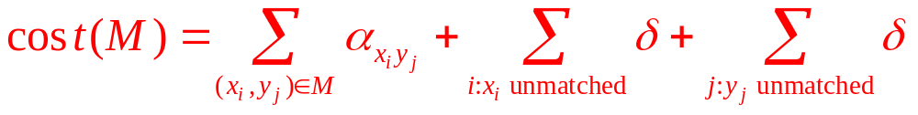
Cost of M
gap
mismatch

Slide 25
Example
Ex. X= ocurrance vs. Y= occurrence
x₁
x₂
x₃
x₄
x₅
x₆
x₇
x₈
x₉
o
c
-
u
r
r
a
n
c
e
o
c
c
u
r
r
e
n
c
e
y₁
y₂
y₃
y₄
y₅
y₆
y₇
y₈
y₉
y₁₀

Slide 26
Sequence Alignment:
Problem Structure
Def. OPT(i, j) = min cost of aligning strings x₁ x₂ . . . x_{i} and y₁ y₂ . . . y_{j} .
Case 1: OPT matches x_{i} - y_{j}.
  pay mismatch for x_{i} - y_{j} + min cost of aligning two strings x₁ x₂ . . . x_{i-1}and y₁ y₂ . . . y_{j-1}
Case 2a: OPT leaves x_{i} unmatched.
  pay gap for x_{i} and min cost of aligning x₁ x₂ . . . x_{i-1}and y₁ y₂ . . . y_{j}
Case 2b: OPT leaves y_{j} unmatched.
  pay gap for y_{j} and min cost of aligning x₁ x₂ . . . x_{i} and y₁ y₂ . . . y_{j-1}

Slide 27
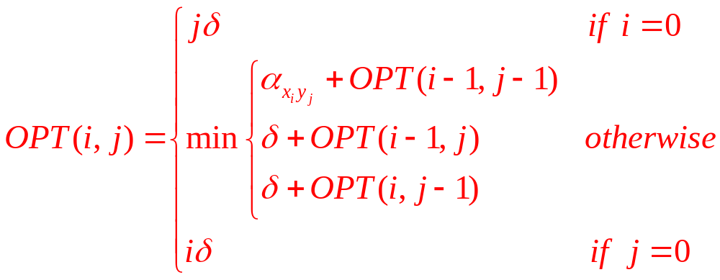
Sequence Alignment:
Dynamic programming

Slide 28
Sequence Alignment:
Algorithm
Sequence-Alignment (m, n, x₁ x₂ . . . x_{m} , y₁ y₂ . . . y_{n} ,δ,α) {
for i = 0 to m
M[0, i] = i δ
for j = 0 to n
M[j, 0] = j δ
for i = 1 to m
for j = 1 to n
M[i, j] = min(α[xi, yj] + M[i-1, j-1], δ + M[i-1, j], δ + M[i, j-1])
return M[m, n]
}

Slide 29
Analysis
Running time and space.
  O(mn) time and space.
English words or sentences: m, n <= 10.
Computational biology: m = n = 100,000. 10 billions ops OK, but 10GB array?

Slide 30
Sequence Alignment in Linear Space
Q. Can we avoid using quadratic space?
Easy. Optimal value in O(m + n) space and O(mn) time.
  Compute OPT (i, •) from OPT (i-1, •).
  No longer a simple way to recover alignment itself.
Theorem. [Hirschberg 1975] Optimal alignment in O(m + n) space and O(mn) time.
  Clever combination of divide-and-conquer and dynamic programming.
  Inspired by idea of Savitch from complexity theory.

Slide 31
Space efficient
j-1
Space-Efficient-Alignment (X, Y)
Array B[0..m,0...1]
Initialize B[i,0] = iδ for each i
For j = 1, ..., n
B[0, 1] = j δ
For i = 1, ..., m
B[i, 1] = min {α[xi, yj] + B[i-1, 0], δ + B[i-1, 1], δ + B[i, 0]}
End for
Move column 1 of B to column 0:
Update B[i ,0] = B[i, 1] for each i
End for
% B[i, 1] holds the value of OPT(i, n) for i=1, ...,m

Slide 32
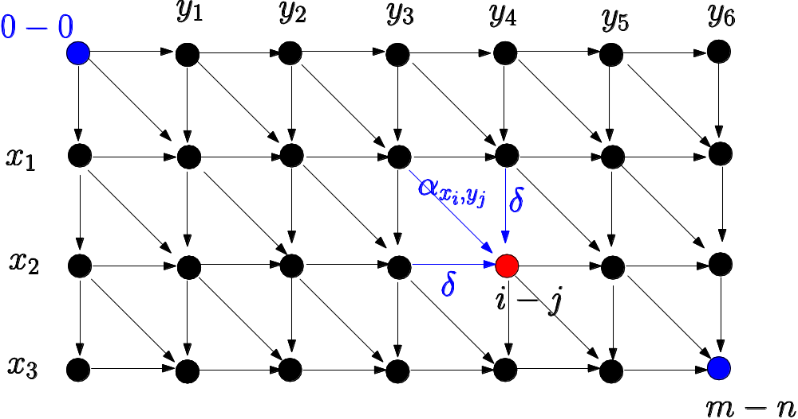
Sequence Alignment:
Linear Space
Edit distance graph.
  Let f(i, j) be shortest path from (0,0) to (i, j).
  Observation: f(i, j) = OPT(i, j).

Slide 33
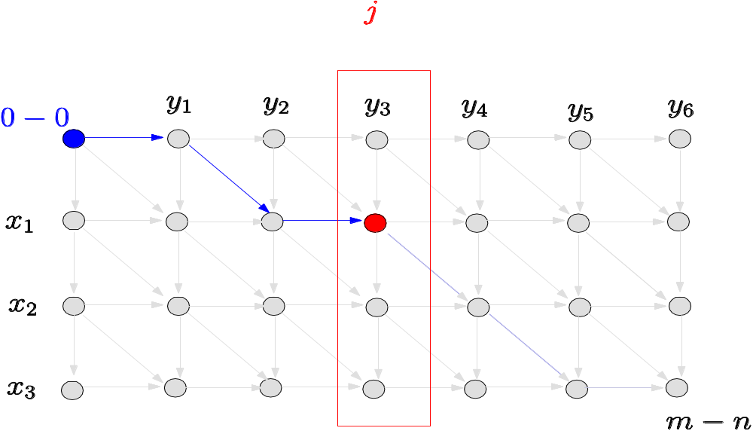
Sequence Alignment:
Linear Space
Edit distance graph.
  Let f(i, j) be shortest path from (0,0) to (i, j).
  Can compute f (•, j) for any j in O(mn) time and O(m + n) space.

Slide 34
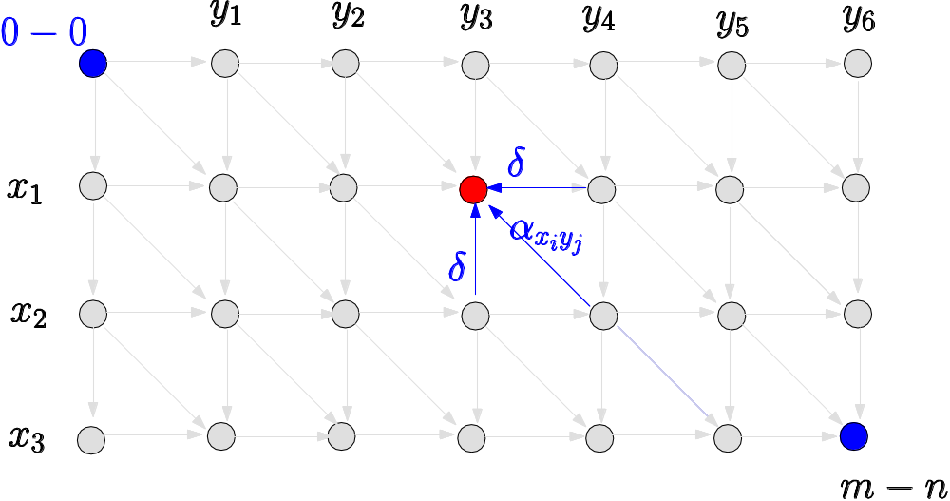
Sequence Alignment:
Linear Space
Edit distance graph.
  Let g(i, j) be shortest path from (i, j) to (m, n).
  Can compute by reversing the edge orientations and inverting the roles of (0, 0) and (m, n)

Slide 35
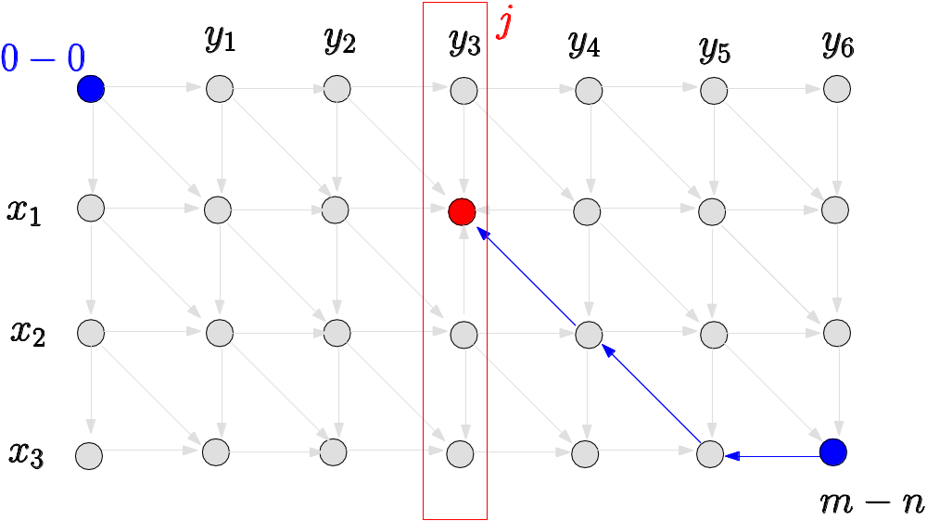
Sequence Alignment:
Linear Space
Edit distance graph.
  Let g(i, j) be shortest path from (i, j) to (m, n).
  Can compute g(•, j) for any j in O(mn) time and O(m + n) space.

Slide 36
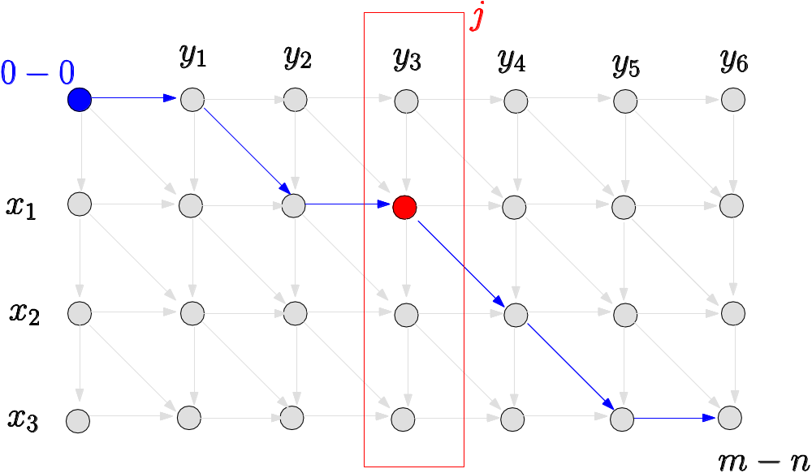
Sequence Alignment:
Linear Space
Observation 1. The cost of the shortest path that uses (i, j) is f(i, j) + g(i, j).

Slide 37
Sequence Alignment:
Linear Space
Observation 2. let q be an index that minimizes f(q, n/2) + g(q, n/2). Then, the shortest path from (0, 0) to (m, n) uses (q, n/2).
Divide: find index q that minimizes f(q, n/2) + g(q, n/2) using DP.
  Align x_{q} and y_{n/2}.
Conquer: recursively compute optimal alignment in each piece.

Slide 38
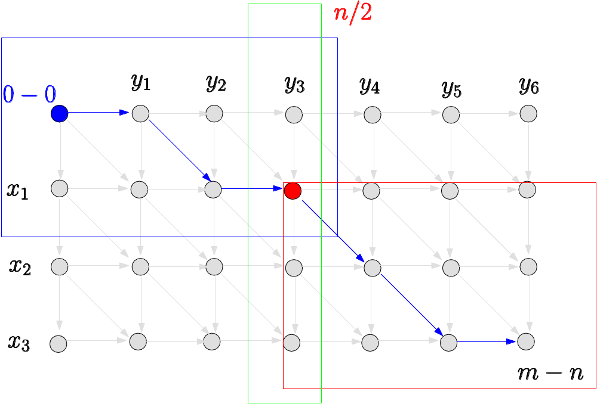

Slide 39
Divide-&-conquer-alignment (X, Y)
DCA(X, Y)
Let m be the number of symbols in X
Let n be the number of symbols in Y
If m<=2 and n<=2 then
computer the optimal alignment
Call Space-Efficient-Alignment(X,Y[1:n/2])
Call Space-Efficient-Alignment(X,Y[n/2+1:n])
Let q be the index minimizing f(q, n/2) + g(q, n/2)
Add (q, n/2) to global list P
DCA(X[1..q], Y[1:n/2])
DCA(X[q+1:n], Y[n/2+1:n])
Return P

Slide 40
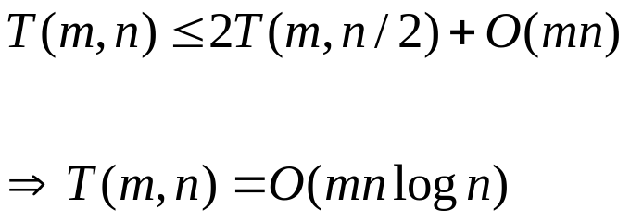
Running time
Theorem. Let T(m, n) = max running time of algorithm on strings of length at most m and n. T(m, n) = O(mn log n).
Remark. Analysis is not tight because two sub-problems are of size
(q, n/2) and (m - q, n/2). In next slide, we save log n factor.

Slide 41
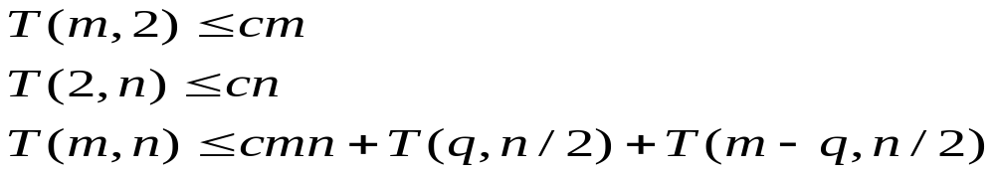
Running time
Theorem. Let T(m, n) = max running time of algorithm on strings of length m and n. T(m, n) = O(mn).
Pf.(by induction on n)
  O(mn) time to compute f( •, n/2) and g ( •, n/2) and find index q.
  T(q, n/2) + T(m - q, n/2) time for two recursive calls.
  Choose constant c so that:

Slide 42
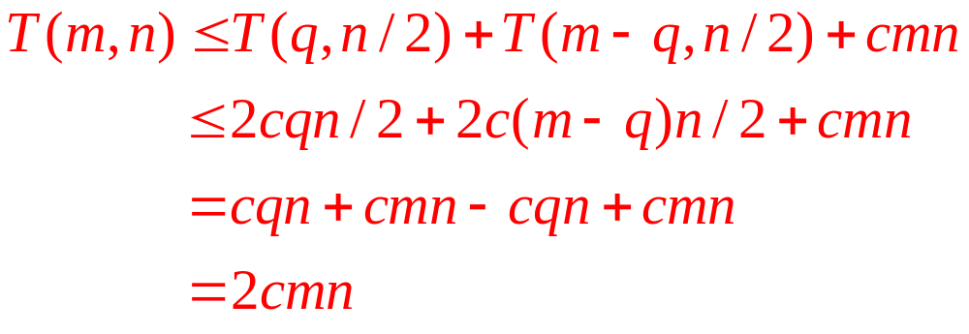
Running time
Base cases: m = 2 or n = 2.
Inductive hypothesis: T(m, n) ≤ 2cmn.

Slide 43
Longest Common
Subsequence (LCS)
Given two sequences x[1 . . m] and y[1 . . n], find a longest subsequence common to them both.
Example:
  x: A B C B D A B
  y: B D C A B A
BCBA = LCS(x, y)
“a” not “the”

Slide 44
Brute-force
LCS algorithm
Check every subsequence of x[1 . . m] to see if it is also a subsequence of y[1 . . n].
Analysis
  Checking = O(n) time per subsequence.
  2^{m} subsequences of x (each bit-vector of length m determines a distinct subsequence of x).
Worst-case running time = O(n2^{m})
= exponential time.

Slide 45
Towards a better algorithm
Simplification:
  1. Look at the length of a longest-common subsequence.
  2. Extend the algorithm to find the LCS itself.
Notation: Denote the length of a sequence s by | s |.
Strategy: Consider prefixes of x and y.
  Define c[i, j] = | LCS(x[1 . . i], y[1 . . j]) |.
  Then, c[m, n] = | LCS(x, y) |.

Slide 46
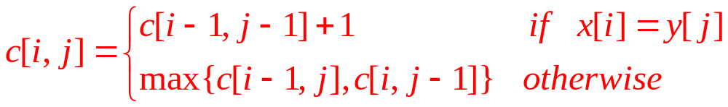
Recursive formulation
Theorem.
Proof. Case x[i] = y[ j]:
Let z[1 . . k] = LCS(x[1 . . i], y[1 . . j]), where c[i, j]= k. Then, z[k] = x[i], or else z could be extended. Thus, z[1 . . k–1] is CS of x[1 . . i–1] and y[1 . . j–1].

Slide 47
1
2
i
m
x :
...
1
j
n
=
y :
...

Slide 48
Proof (continued)
Claim: z[1 . . k–1] = LCS(x[1 . . i–1], y[1 . . j–1]).
Suppose w is a longer CS of x[1 . . i–1] and y[1 . . j–1], that is, |w| > k–1. Then, cut and paste: w || z[k] (w concatenated with z[k]) is a common subsequence of x[1 . . i] and y[1 . . j] with |w || z[k]| > k. Contradiction, proving the claim.
Thus, c[i–1, j–1] = k–1, which implies that c[i, j] = c[i–1, j–1] + 1.
Other cases are similar.

Slide 49
Dynamic-programming hallmark
Optimal substructure
An optimal solution to a problem (instance) contains optimal solutions to subproblems.
If z = LCS(x, y), then any prefix of z is an LCS of a prefix of x and a prefix of y.

Slide 50
Recursive algorithm for LCS
LCS (x, y, i, j )
if
x[i ] = y[ j ]
then
c[i, j] ← LCS(x, y, i–1, j–1) + 1
else
c[i, j] ← max{LCS(x, y, i–1, j), LCS(x, y, i, j–1)}

Slide 51
Recursion tree
Worst-case: x[i ] ≠ y[ j ], in which case the
algorithm evaluates two subproblems each
with only one parameter decremented.
m=3,n=4
3,4
m+n level
2,4
3,3
2,3
3,2
1,4
2,3
Thus, it may work potentially exponential.

Slide 52
Recursion tree
What happens? The recursion tree though may work in exponential time. But we’re solving subproblems already solved!
3,4
Same subproblems
2,4
3,3
2,3
3,2
1,4
2,3

Slide 53
Dynamic-programming hallmark
The number of distinct LCS subproblems for two strings of lengths m and n is only mn.
Overlapping subproblems
A recursive solution contains a
“small” number of distinct
subproblems repeated many times.

Slide 54
Memoization algorithm
Memoization: After computing a solution to a subproblem, store it in a table. Subsequent calls check the table to avoid redoing work.
Same algorithm as before, but
Time = Θ(mn) = constant work per table entry.
Space = Θ(mn).

Slide 55
Reconstruct
LCS
A
B
C
B
D
A
B
IDEA:
 | 0 | 0 | 0 | 0 | 0 | 0 | 0
0 | 0 | 1 | 1 | 1 | 1 | 1 | 1
0 | 0 | 1 | 1 | 1 | 2 | 2 | 2
0 | 0 | 1 | 2 | 2 | 2 | 2 | 2
0 | 1 | 1 | 2 | 2 | 2 | 3 | 3
0 | 1 | 2 | 2 | 3 | 3 | 3 | 4
0 | 1 | 2 | 2 | 3 | 3 | 4 | 4
Reconstruct
LCS by tracing
backwards.
B
D
C
A
B
A

Slide 56
Reconstruct
LCS
A
B
C
B
D
A
B
IDEA:
 | 0 | 0 | 0 | 0 | 0 | 0 | 0
0 | 0 | 1 | 1 | 1 | 1 | 1 | 1
0 | 0 | 1 | 1 | 1 | 2 | 2 | 2
0 | 0 | 1 | 2 | 2 | 2 | 2 | 2
0 | 1 | 1 | 2 | 2 | 2 | 3 | 3
0 | 1 | 2 | 2 | 3 | 3 | 3 | 4
0 | 1 | 2 | 2 | 3 | 3 | 4 | 4
Reconstruct
LCS by tracing
backwards.
B
D
C
A
B
A

Slide 57
Reconstruct
LCS
A
B
C
B
D
A
B
IDEA:
 | 0 | 0 | 0 | 0 | 0 | 0 | 0
0 | 0 | 1 | 1 | 1 | 1 | 1 | 1
0 | 0 | 1 | 1 | 1 | 2 | 2 | 2
0 | 0 | 1 | 2 | 2 | 2 | 2 | 2
0 | 1 | 1 | 2 | 2 | 2 | 3 | 3
0 | 1 | 2 | 2 | 3 | 3 | 3 | 4
0 | 1 | 2 | 2 | 3 | 3 | 4 | 4
Reconstruct
LCS by tracing
backwards.
Another solution
B
D
C
A
B
A

Slide 58
LCS: summary
Running time O(mn), Space O(mn)
Can we improve this result ?

Slide 59
LCS up to date
Hirschberg (1975) reduced the space complexity to O(n), using a divide-and-conquer approach.
Masek and Paterson(1980):
  O(n²/ log n) time. J. Comput. System Sci., 20:18–31, 1980.
A survey: L. Bergroth, H. Hakonen, and T. Raita. SPIRE ’00:

Slide 60
LCIS
Longest common increasing subsequence
  Longest common subsequence, and it is also a increasing subsequence.

Slide 61
Chain matrix multiplication
Suppose we want to multiply four matrices, A × B × C × D, of dimensions 50 × 20, 20 × 1, 1×10, and 10×100.
(A × B) × C = A × (B × C)? Which one do we choose?
×
×
×
c
1 × 10
D
10 × 100
A
50 × 20
B
20 × 1

Slide 62
×
×
A
50 × 20
D
10 × 100
B ×C
20 × 10
×
D
10 × 100
A × (B ×C)
50 × 10
(A × B ×C) ×D
50 × 100

Slide 63
Different evaluating
Parenthesization | Cost computation | Cost
A × ((B × C) × D) | 20·1·10 + 20·10·100 + 50·20·100 | 120, 200
(A × (B × C)) × D | 20 ·1·10 + 50· 20· 10 + 50·10·100 | 60, 200
(A × B) × (C × D) | 50 ·20·1 + 1·10·100 + 50·1·100 | 7,000

Slide 64
Number of parenthesizations
However, exhaustive search is not efficient.
Let P(n) be the number of alternative parenthesizations of n matrices.
P(n) = 1, if n=1
P(n) = ∑_{k=1 to n-1} P(k)P(n-k), if n ≥ 2
P(n) ≥ 4^{n-1}/(2n²-n). Ex. n = 20, this is > 2²⁸.

Slide 65


How do we determine the optimal order, if we want to compute with dimensions
Binary tree representation
A
D
C
D
B
C
A
B

Slide 66
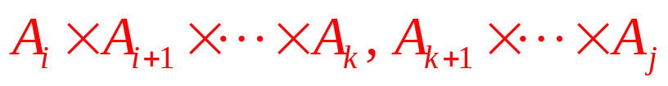
The binary trees of Figure are suggestive: for a tree to be optimal, its subtrees must also be optimal. What is the subproblems?
Clearly, C(i,i)=0.
Consider optimal subtree at some k,

Slide 67
Optimum subproblem
Running time O(n³)

Slide 68
Algorithm matrixChain(P):
Input: sequence P of P matrices to be multiplied
Output: number of operations in an optimal parenthesization of P
n ← length(P) - 1
  for i ← 1 to n do
  C[i, i] ← 0
  for l ← 2 to n do
  for i ← 0 to n-l-1 do
  j ← i+l-1
  C[i, j] ← +infinity
  for k ← i to j-1 do
  C[i, j] ← min{C[i,k] + C[k+1, j] +p_{i-1} p_{k} p_{j}}

Slide 69

Independent sets in trees
Problem: A subset of nodes is an independent set of graph G = (V,E) if there are no edges between them.
For example, {1,5} is an independent set, but {1,4, 5} is not.
1
2
5
6
3
4

Slide 70
The largest independent set in a graph is NP-hard
But in a tree might be easy!
What are the appropriate subproblems?
  Start by rooting the tree at any node r. Now, each node defines a subtree -- the one hanging from it.
  I(u) = size of largest independent set of subtree hanging from u
  Goal: Find I(r)

Slide 71
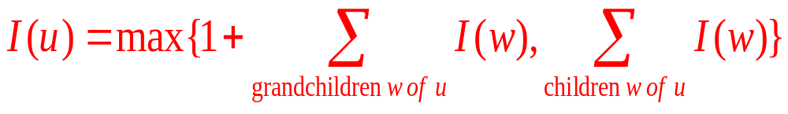
Case 1. Include u, all its children are not include
Case 2, not include u, sum of all children’s value
The number of subproblems is exactly the number of vertices. Running time: O(|V|+|E|)

Slide 72
Dynamic programming:
Summary
Optimal substructure
  An optimal solution to a problem (instance) contains optimal solutions to subproblems
Overlapping subproblems
  A recursive solution contains a “small” number of distinct subproblems repeated many times.

